Slide 1
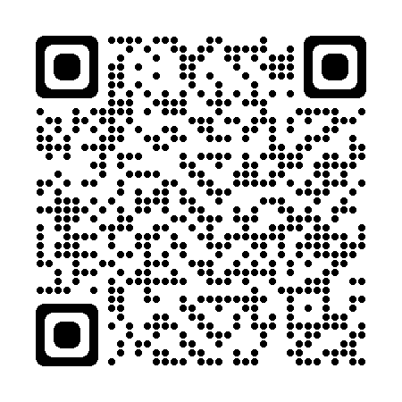
Who are the MTFEE?? Why should I support it?? How to keep it alive!
Millstone Township Foundation for Educational Excellence
What have we granted?
How we raise $
Est. 2002
Non-Profit Organization overseen by Parent Volunteers who raise, fund and decide what grants are given at the end of each school year.
STEAM
Technology
Literacy
Health & Wellness
www.mtfee.org/mtf/
millstoneMTFEE@gmail.com
Follow us on Facebook
Outdoor classrooms
Bookworm Vending Machine
Escape Room
Garden Club
Virtual Reality Carts
Interactive Technology Table
3D Printers
Welch Allyn Vision Screener
STEAM Makerspace
Programmable Robotics
Rock Wall
Smart Boards
iPads
Digital Microscopes
AND MANY MORE!!!!!!!!!
Boo Bags (October)
Cupid Bags (February)
Local Businesses
Family Sponsors
1 Big Fundraising Event
We need your help!!
Keep the MTFEE alive!
Volunteer
TODAY!!!!

